Slide 1
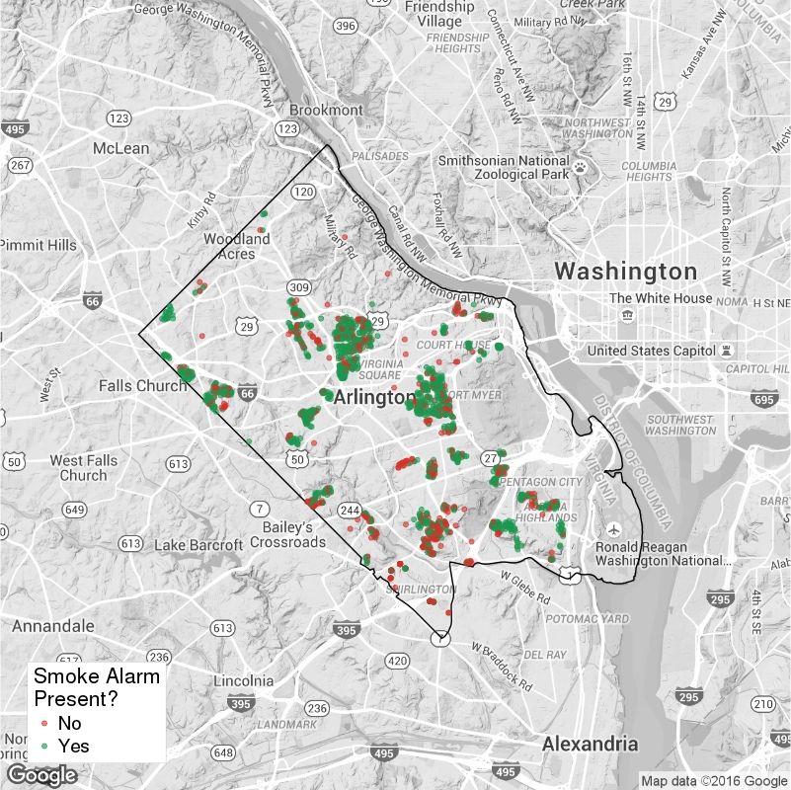
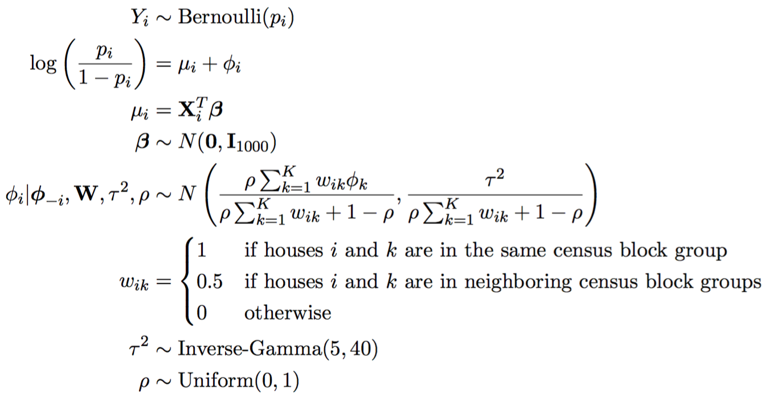
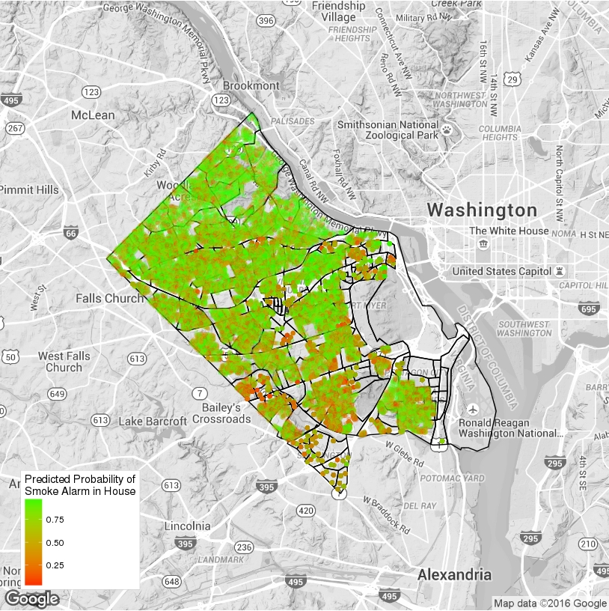
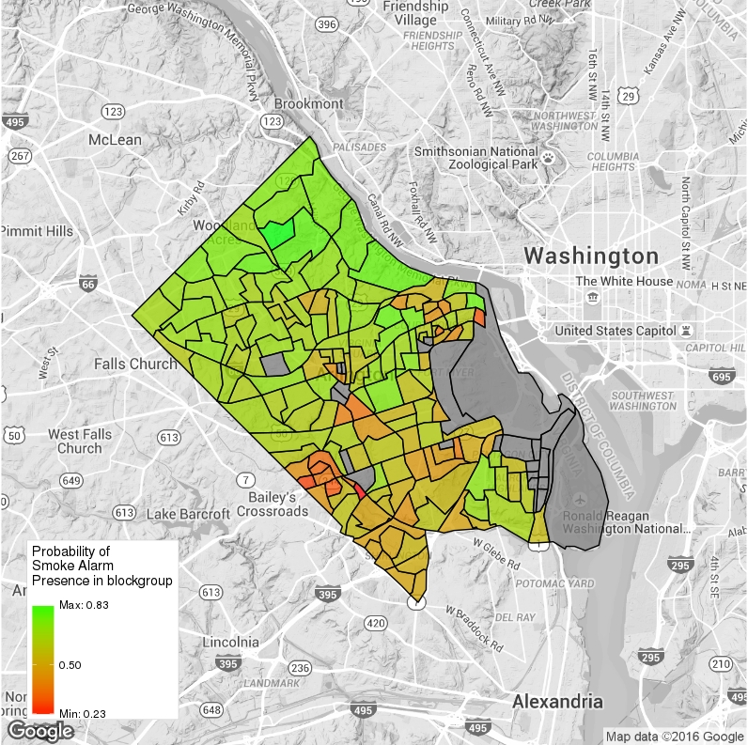
Residential Smoke Alarm Need
in Arlington County
Data Science for the Public Good
Mark Almanza (Virginia Tech), Will Sandholtz (UC Berkeley), Sam Tyner (Iowa State)
with Gizem Korkmaz, Joshua Goldstein, and Vicki Lancaster (SDAL),
Research Question
Are there characteristics that can be used to identify homes that do not have smoke alarms installed? Can these characteristics be used in a model for prediction to aid the Arlington County Fire Department (ACFD) with their Operation FireSafe program?
BACKGROUND: The ACFD runs the Operation FireSafe initiative to increase the number of residences in the county with smoke alarms. Building a model to identify homes most in need of an alarm may increase the effectiveness of the program. A similar data-driven effort was implemented in New Orleans [1].
Data Sources
Operation Firesafe
ACFD visited 5623 unique addresses in Arlington.
1,733 visits contained information on presence of smoke alarms in the home.
32 percent of these homes did not previously have smoke alarms installed.
The dataset includes time and date of the visit, address, outcome, number of alarms installed, and number of alarms in the home before the visit.
CoreLogic
The dataset contains information, such as house value, size, age, number of bedrooms, and ownership, for 60,343 housing units in Arlington County.
Operation FireSafe visits in Arlington County.
Modelling Smoke Alarm Need
Taking into account the locations of residential units in Arlington County and incorporating the merged Operation Firesafe and CoreLogic data sources, we build a model to predict regions of the county in need of smoke alarms.
We fit a Bayesian logistic regression model [2] with conditionally autoregressive spatial effects. Two factors effect the predicted probabilities: 1. the covariates of interest and
2. the location (census block group) of the home.
The response is a Bernoulli random variable at the level of the home:
Y_{i} = 0 no smoke alarm, ACFD installed one or more alarms and
Y_{i} = 1 one or more smoke alarms already present.
The covariates of interest that we use in modelling are:
the natural log of the value of the home (a proxy for income)
the age of the home
an indicator of whether or not the residence is a condo
the number of bedrooms (a proxy for household size)
an indicator of whether or not the residence is owner occupied
The parameter estimates and credible intervals are given below:
Parameter Value | Posterior Median | 95% Credible Interval
Intercept* | -30.12 | (-59.60, -20.39)*
log(HomeValue)* | 2.45 | (1.67, 4.83)*
Age* | -0.0109 | (-0.0257, -0.0022)*
Condo Indicator | -0.48 | (-1.58, 0.22)
Number of Bedrooms | -0.12 | (-0.39, 0.09)
Owner Occupied Indicator | 0.02 | (-0.61, 0.65)
* Effect is significant at 5% level
The model estimates the probability that a housing unit has a smoke alarm. Because of the spatial dependence included in the model, the predictions are made for each residential unit in the CoreLogic data source that are:
in census block groups that appeared in the original data or in a census block group neighboring those in the original data; and
with no missing covariate values and/or census block group information.
Consequently, predictions are made for 49,178 residential units.
The figure on the left shows the probability of each home having a smoke alarm. The lower the predicted probability (red areas) the more likely the home lacks a smoke alarm. The figure on the right shows the average probability for homes within a census block group.
By focusing on the homes with a low probability of an installed smoke alarm, the ACFD can better target future Operation FireSafe visits.
Our next step is to incorporate other sources of data (e.g., American Community Survey (ACS)) into the model to capture the effects of sociodemographic characteristics.
References
bi.vt.edu/sdal
[1]“City Launches New Smoke Alarm Initiative Based on Data Analytics”, Mayoral Press Release, City of New Orleans. http://www.nola.gov/mayor/press-releases/2015/20150331-smoke-alarm-data-campaign/
[2] Duncan Lee (2016). CARBayes: Spatial Generalised Linear Mixed Models for Areal Unit Data. R package version 4.6. https://CRAN.R-project.org/package=CARBayes

